Slide 1
DIGESTIVE DISEASES
2022-2025 Edition
UNIGASTRO
Coordinamento Nazionale Docenti Universitari
di Gastroenterologia
EDITRICE GASTROENTEROLOGICA ITALIANA
N
A
M
E
N
T
I
O
R
D
N
O
A
O
Z
C
I
-
O
3
N
9
A
9
L
1
E
-
A
D
I
E
G
I
O
D
L
O
O
C
R
E
E
N
T
T
N
I
E
D
O
R
T
A
G
I
S

Slide 2
DIGESTIVE
DISEASES
2022-2025 Edition
TRIM SIZE 19,5 x 26,5
EXTENT 440 PAGES PAPERBACK
ISBN 978-88-214-5635-0
€ 60 $ 75 £ 60
FULL COLOR
UNIGASTRO
N
A
M
E
N
T
O
Coordinamento Nazionale
I
N
D
A
R
Z
O
I
O
O
C
N
Docenti Universitari
-
A
3
L
9
E
9
1
D
-
E
A
I
I
D
di Gastroenterologia
G
O
O
C
L
E
O
N
R
T
E
I
T
D
N
E
O
R
S
A
G
I
T
EDITRICE GASTROENTEROLOGICA ITALIANA

Slide 3
DIGESTIVE DISEASES
2022-2025 Edition
UNIGASTRO
UNIGASTRO (National Academic Committee in Gastroenterology) is an association focused on promoting high-level teaching in Gastroenterology.
Over the last 25 years UNIGASTRO has been working on a textbook thought for the students who attend the classes of Gastroenterology in the different integrated courses of the Medicine and Surgery degree, published by Editrice Gastroenterologica Italiana every three years.
The new edition offers students a textbook that takes into account the continuous growth of scientific research and provides the necessary knowledge for a correct transition from theory to clinical practice.

Slide 4
DIGESTIVE DISEASES
2022-2025 Edition
CONTENTS
The volume is composed of 51 chapters, organized in 6 sections:
The first section (chapters 1-4) presents introductory topics, with a special focus on nutrition, malnutrition, microbiota and New Technologies;
The second section (chapters 5-14) discusses oesophagus, stomach, and duodenum diseases;
The third section (chapters 15-26) describes small bowel and colon diseases.
The fourth section (chapters 27-38) focuses on liver diseases;
The fifth section (chapters 39-48) is centred around the biliary tract and pancreas diseases;
The sixth section (chapters 49-51) discusses the emergencies in Gastroenterology.

Slide 5
DIGESTIVE DISEASES
2022-2025 Edition
MATERIALS
ONLINE
As for the previous editions, the handbook is made up of both a paper book and a completely renewed multimedia content that are accessible
directly through a code printed on the inner cover. Students gain access to:
CLINICAL CASES
1. Chronic Abdominal Pain 2. Acute Abdominal Pain 3. Pyrosis and Epigastralgia
4. Digestive Bleeding 5. Disorders of the Bowel Habits 6. Hypertransaminasemia
7. Anemia 8. Jaundice 9. Dysphagia 10. Ascite
DIAGNOSTIC PROCEDURES
1. Breath Test 2. Esophageal manometry, pH- and pH-Impedance monitoring
3. Paracentesis 4. Percutaneous Endoscopic Gastrostomy (PEG)
5. Esophagogastroduodenoscopy 6. Colonscopy
Endoscopic Retrograde Cholangiopancreatography
Endoscopic Ultrasound 9. Enteroscopy 10. Abdominal Ultrasonography
11. Liver Biopsy 12. CT and Nuclear Magnetic Resonance
13. Endoscopic Therapeutic Procedures 14. Interventional Radiology
EXTRA CONTENTS
1. Pregnancy and Gastroenterological Diseases 2. Skin and Oral Lesions In Gastroenterological Disorders 3. Intestinal Mucosal Immunity
4. Covid-19 and Digestive Diseases
SELF-ASSESSMENTS
Multiple Choice Questions by Chapter

Slide 6
DIGESTIVE DISEASES
2022-2025 Edition
EDUCATIONAL
TOOLS
Each chapter of the volume displays its learning objectives summarised in the first page, giving the student a guide for their preparation. Essential key concepts and up-to-date references are indicated at the end of each chapter.
LEARNING OBJECTIVES
To provide the epidemiology, anatomiclinical characteristics, clinical outcome, course, and
complications of Crohn’s disease.
To understand difficulties in diagnosis and indications for diagnostic techniques in Crohn’s disease. To learn the indications for medical and surgical treatments for Crohn’s disease.
KEY CONCEPTS
Crohn’s Disease is a chronic inflammatory disease of unknown aetiology, characterized by recurrent
phases of remission and relapse of symptoms, mainly diarrhoea, abdominal pain, weight loss, fever. Intestinal lesions in Crohn’s Disease may Involve any area of the gastrointestinal tract, although more frequently the terminal Ileum and the colon. Typical features include transmural Inflammation, focal and patchy lesions, and fibrostricturing, fistulizing or non-penetrating non-fistulizing behavior.
The diagnosis may be difficult, as there is no a gold standard diagnostic approach. Endoscopic and
radiological findings may help to support diagnosis, to define disease activity and complications, and for assessing its course.

Slide 7
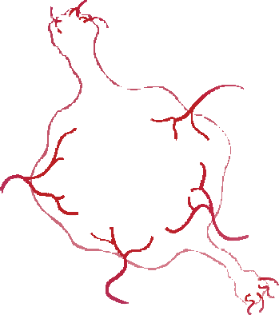
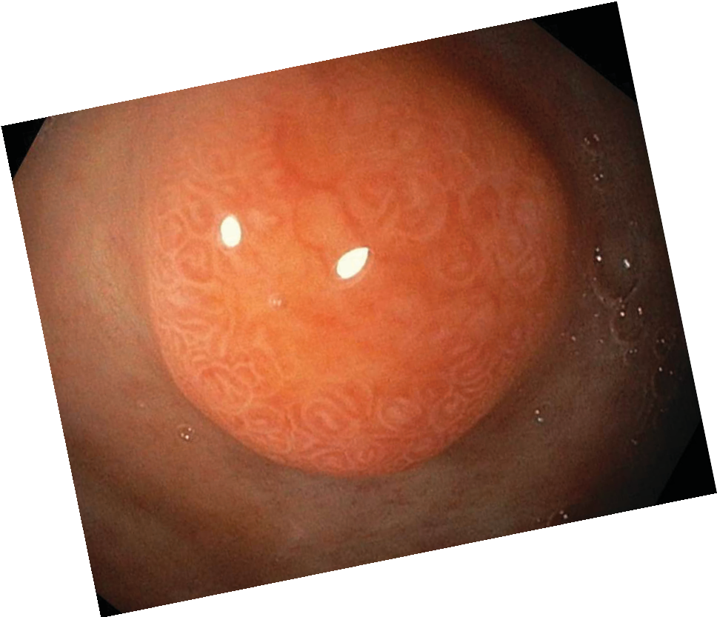
DIGESTIVE DISEASES
2022-2025 Edition
EDUCATIONAL
TOOLS
This new edition provides to the students a user-friendly manual, up to date with the most recent research and rich of full color illustrations and photographs.
NSAIDs
TOPICAL
SYSTEMIC
Phospholipid binding
COX
dependent
Mesenteric Tapeworm
Antimesenteric Tapeworm
V Mucus viscosity
COX-1
COX-2
Vascular structure
Mucosa permeability
V Prostaglandins
V PGE₂ - PGI₂ - TXA₂
H+ back diffusion
V Mucosa protection V Blood Flow
Mucosa damage
Mucosa damage

